Slide 1

Data Modeling and the Entity-Relationship Model
DAVID M. KROENKE and DAVID J. AUER
DATABASE CONCEPTS, 7th Edition, Global Edition
Chapter Four

Slide 2
Chapter Objectives
Learn the basic stages of database development
Understand the purpose and role of a data model
Know the principal components of the E-R data model
Understand how to interpret traditional E-R diagrams
Understand how to interpret the Information Engineering (IE) model’s Crow’s Foot E-R diagrams
Learn to construct E-R diagrams
Know how to represent 1:1, 1:N, N:M, and binary relationships with the E-R model
Notes:
A data model is a representation of the content, relationships, and constraints of the data needed to support the system requirements.
The most important elements of the E-R model are entities, attributes, identifiers, and relationships.
Information Engineering (IE) [James Martin 1990]—Uses “crow’s feet” to show the many sides of a relationship, and it is sometimes called the crow’s foot model.
crow 미국식 [kroʊ] 영국식 [krəʊ] 1. [명사] 까마귀 2. [명사] 수탉 울음소리(같은 소리), 환성 3. [동사] (특히 이른 새벽에) ‘꼬끼오’하고 울다
2. (못마땅함) (특히 다른 사람은 실패한 판에 자기가 성공한 것을) 마구 자랑하다[떠들어대다] He won’t stop crowing about his victory. 그가 자기 승리에 대해 떠들어 대길 그만두지 않을 거야. ‘I’ve won, I’ve won!’ she crowed. “내가 이겼어, 내가 이겼다고!” 그녀가 마구 자랑했다.

Slide 3
Chapter Objectives (Cont’d)
Understand two types of weak entities and know how to use them
Understand nonidentifying and identifying relationships and know how to use them
Know how to represent subtype entities with the E-R model
Know how to represent recursive relationships with the E-R model
Learn how to create an E-R diagram from source documents
Notes:
A weak entity is an entity that cannot exist in the database without the existence of another entity.
Identifying relationship: A relationship that is used when the child entity is ID-dependent upon the parent entity.
To be an ID-dependent entity, the identifier of the entity APARTMENT must contain the identifier of the entity BUILDING on which it depends.
A subtype entity is a special case of another entity called the supertype entity. Students, for example, may be classified as undergraduate or graduate students. In this case, STUDENT is the supertype, and UNDERGRADUATE and GRADUATE are subtypes.
It is possible for an entity to have a relationship to itself—this is called a recursive relationship.

Slide 4
Three Stages of Database Development
The 3 stages of database development
Part of the 5-stage SDLC model
Requirements Analysis Stage: Conceptual design
During this stage (also referred to as the requirements stage), system users are interviewed and sample forms, reports, queries, and descriptions of update activities are obtained.
These system requirements are used to create a data model as part of the requirements analysis stage.
Component Design Stage: Logical design
During this stage (also referred to as the system design stage and the design stage), the data model is transformed into a database design.
Implementation Stage: Physical design
During this stage, the database is constructed in the DBMS and populated with data; queries, forms, and reports are created; application programs are written; and all these are tested
Finally, during this stage users are trained, documentation is written, and the new system is put into use.
Systems Development Life Cycle (SDLC) model
The classic methodology used in systems analysis and design to develop information systems
System definition
Requirements analysis
Component design
Implementation
System maintenance
Notes:
During the requirements analysis stage (also referred to as the requirements stage), system users are interviewed and sample forms, reports, queries, and descriptions of update activities are obtained. These system requirements are used to create a data model as part of the requirements analysis stage.
A data model is a representation of the content, relationships, and constraints of the data needed to support the system requirements.
During the component design stage (also referred to as the system design stage and the design stage), the data model is transformed into a database design.
Such a design consists of tables, relationships, and constraints. The design includes the table names and the names of all table columns.
The last stage of database development is the implementation stage. During this stage, the database is constructed in the DBMS and populated with data; queries, forms, and reports are created; application programs are written; and all these are tested. Finally, during this stage users are trained, documentation is written, and the new system is put into use.

Slide 5
The Requirements Analysis Stage
Sources of requirements
User Interviews
Forms
Reports
Queries
Use Cases
Business Rules
Notes:
During the requirements analysis stage (also referred to as the requirements stage), system users are interviewed and sample forms, reports, queries, and descriptions of update activities are obtained. These system requirements are used to create a data model as part of the requirements analysis stage.
Use cases are descriptions of the ways users will employ the features and functions of the new information system. In systems analysis and design, a detailed example of how a user interacts with an information system or application.
Finally, during the process of establishing requirements system developers need to document business rules that constrain actions on database activity.
• Students must declare a major before enrolling in any class.
• No adviser may have more than 25 advisees.

Slide 6
Requirements Become the E-R Data Model
After the requirements have been gathered,
they are transformed into an Entity Relationship (E-R) Data Model
The most important elements of E-R Models are:
Entities
Attributes
Identifiers
Relationships

Slide 7
Entity Class versus Entity Instance
An entity class is a description of the structure and format of the occurrences of the entity.
An entity instance is a specific occurrence of an entity within an entity class.

Slide 8
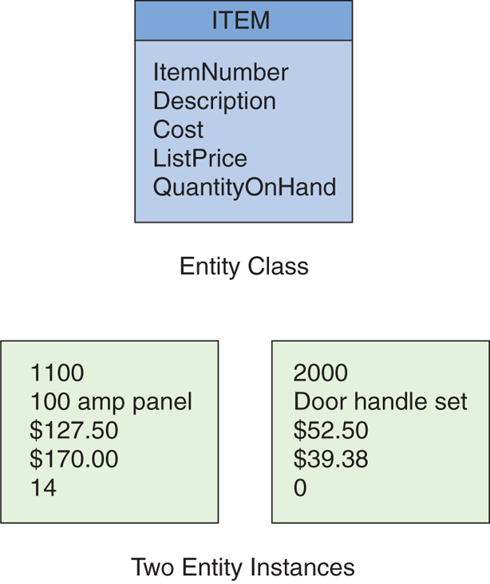
Entity Class and Entity Instance
Figure 4-2: The ITEM Entity and Two Entity Instances

Slide 9
Attributes
Entities have attributes that describe the entity’s characteristics:
ProjectName, StartDate
ProjectType, ProjectDescription
Attributes have a data type and properties.
Properties are determined from the requirements
Properties specify whether the attribute is required, whether it has a default value, whether its value has limits, and any other constraint.
Notes:
An attribute has a data type (character, numeric, date, currency, and the like) and properties that are determined from the requirements. Properties specify whether the attribute is required, whether it has a default value, whether its value has limits, and any other constraint.

Slide 10
Identifiers
Entity instances have identifiers.
An identifier will identify a particular instance in the entity class:
SocialSecurityNumber
StudentID
EmployeeID

Slide 11
Identifier Types
Uniqueness
Identifiers may be unique or nonunique.
If the identifier is unique, the data value for the identifier must be unique for all instances.
Composite
A composite identifier consists of two or more attributes.
E.g., OrderNumber & LineItemNumber are both required.

Slide 12
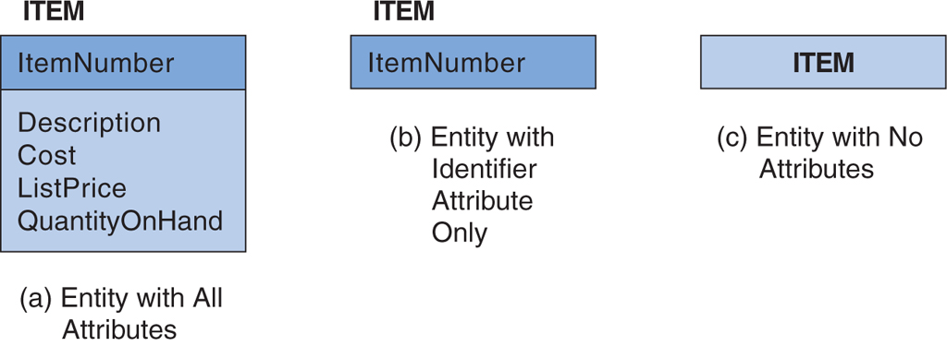
Levels of Entity Attribute Display
Figure 4-3: Levels of Entity Attribute Display

Slide 13
Relationships
Entities can be associated with one another in relationships.
Relationship degree defines the number of entity classes participating in the relationship:
Degree 2 is a binary relationship.
Degree 3 is a ternary relationship.
Notes:
Relationship The condition or fact of being related; connection or association.
The sequence continues with quaternary, quinary, senary, septenary, octonary, nonary, and denary, although most of these terms are rarely used. There's no word relating to the number eleven but there is one that relates to the number twelve: duodenary.
미국식 [ kw’ɑtərnèri ] 영국식 [ kwətə́:nəri ]
Corresponding to base (radix) values of 2,3,4,5,6,7,8,9,10,11,12,16,20, and 60, the numeral notation systems are called binary, ternary, quaternary, quinary, senary, septenary, octenary (or octal), nonary, denary (decimal), undenary, duodenary, hexadecimal, vigesimal, and sexagesimal, respectively.

Slide 14
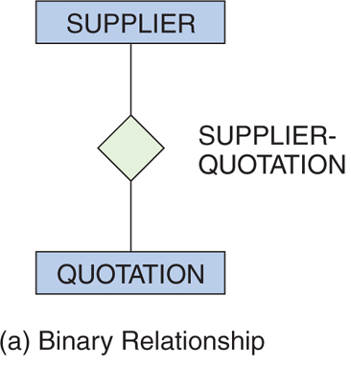
Degree 2 Relationship: Binary
Figure 4-4: Example Relationships

Slide 15
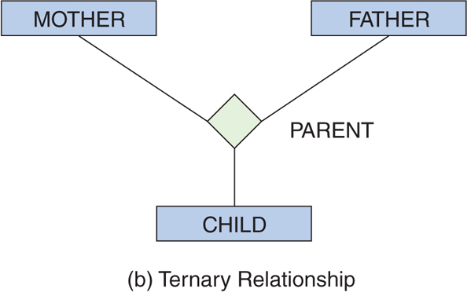
Degree 3 Relationship: Ternary
Figure 4-4: Example Relationships

Slide 16
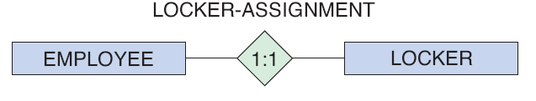
One-to-One Binary Relationship
1:1 (one-to-one)
A single entity instance in one entity class is related to a single entity instance in another entity class.
An employee may have no more than one locker; and
A locker may only be accessible by one employee
(a) One-to-One Relationship
Figure 4-5: Three Types of Binary Relationships

Slide 17
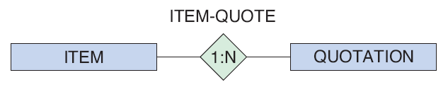
One-to-Many Binary Relationship
1:N (one-to-many)
A single entity instance in one entity class is related to many entity instances in another entity class.
A quotation is associated with only one item; and
An item may have several quotations
(b) One-to-Many Relationship
Figure 4-4: Three Types of Binary Relationships

Slide 18
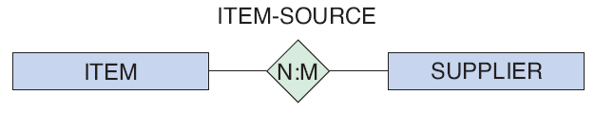
Many-to-Many Binary Relationship
N:M (many-to-many)
Many entity instances in one entity class is related to many entity instances in another entity class:
a supplier may supply several items; and
a particular item may be supplied by several suppliers.
(c) Many-to-Many Relationship
Figure 4-5: Three Types of Binary Relationships

Slide 19
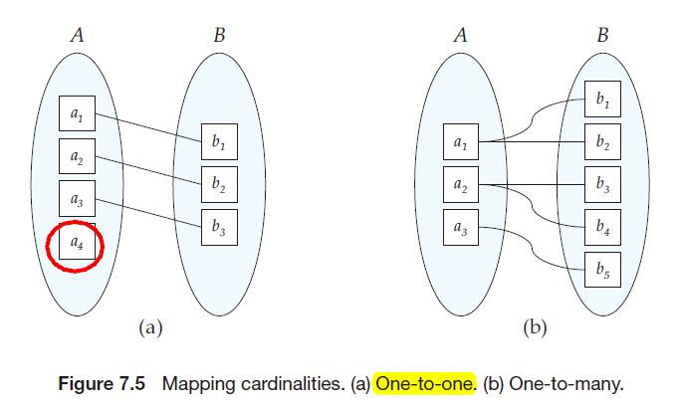
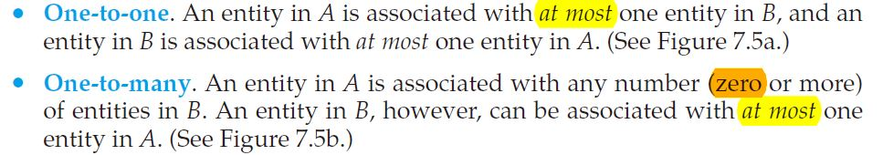
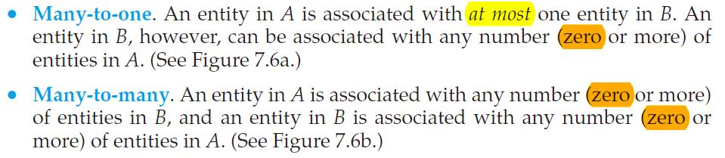
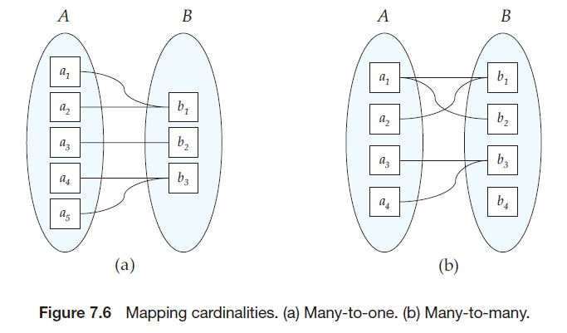
Binary Relationships

Slide 20
Maximum Cardinality
Relationships are named and classified by their cardinality,
which is a word that means count.
Each of the three types of binary relationships shown above have
different maximum cardinalities.
Maximum cardinality is the maximum number of entity instances
that may participate in a relationship instance—one, many, or some other fixed number.
Notes:
car·din·al 1.추기경 2.기수(1, 2, 3 등 양을 나타내는 수) 3.가장 중요한[기본적인]

Slide 21
Minimum Cardinality
Minimum cardinality is
the minimum number of entity instances that must participate in a relationship instance.
These values typically assume
a value of zero (optional) or one (mandatory).
Notes:
man·da·tory [ |mændətɔːri; mæn|deɪtəri ] 1. 명령의, 지령의, 명령적인; 〈법률〉 강제적인, 의무적인; (…에게) 필수의. 2. 위임의, 위탁의; 통치를 위임받은. 3. =mandatary. -ri·ly 부사

Slide 22
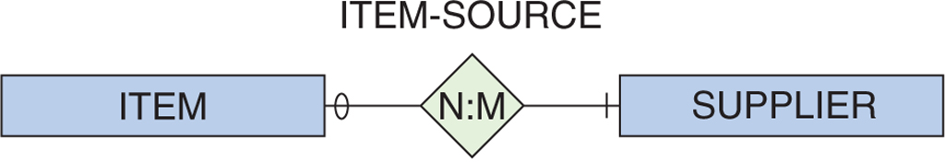
Cardinality Example
Maximum cardinality is many for both ITEM and SUPPLIER.
Minimum cardinality is zero (optional) for ITEM and one (mandatory) SUPPLIER.
A SUPPLIER does not have to supply an ITEM.
An ITEM must have a SUPPLIER.
Figure 4-6: A Relationship with Minimum Cardinalities
Notes:
In each of the relationships in Figure 4-5, the numbers inside the relationship diamond show the maximum number of entity instances that can occur on each side of the relationship. These numbers are called the relationship’s maximum cardinality, which is the maximum number of entity instances that can participate in a relationship instance.

Slide 23
Entity-Relationship Diagrams
The diagrams in previous slides are called entity-relationship diagrams.
Entity classes are shown by rectangles.
Relationships are shown by diamonds.
The maximum cardinality of the relationship is shown inside the diamond.
The minimum cardinality is shown by the oval or hash mark next to the entity.
The name of the entity is shown inside the rectangle.
The name of the relationship is shown near the diamond.

Slide 24
HAS-A Relationships
The relationships in the previous slides are called HAS-A relationships.
Slides 4-16~18, 4-22
The relationships that connect supertypes and subtypes are called IS-A relationships because a subtype is the same entity as the supertype. (4-39)
The term is used because each entity instance has a relationship to a second entity instance:
An employee has a badge.
A badge has an employee.
Notes:
The relationships that connect supertypes and subtypes are called IS-A relationships because a subtype is the same entity as the supertype. (4-39)
Contrast this with HAS-A relationships, in which an entity has a relationship to another entity but the identifiers of the two entities are different.

Slide 25
Types of Entity-Relationship Diagrams
Information Engineering (IE) [James Martin 1990]—Uses “crow’s feet” to show the many sides of a relationship, and it is sometimes called the crow’s foot model.
Integrated Definition 1, Extended 3 (IDEF1X) is a version of the E-R model that is a national standard.
Unified Modeling Language (UML) is a set of structures and techniques for modeling and designing object-oriented programs (OOP) and applications

Slide 26
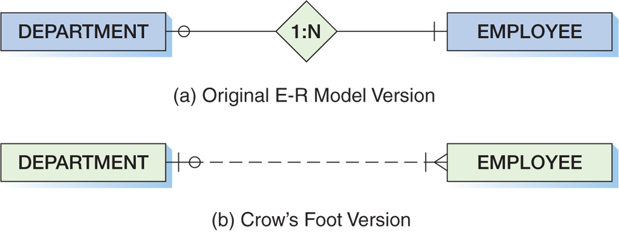
Crow’s Foot Example: One-to-Many Relationship
Figure 4-7: Two Versions of a 1:N Relationship
Notes:
In the IE Crow’s Foot model, the symbol closest to the entity shows the maximum cardinality, and the other symbol shows the minimum cardinality. A hash mark indicates one (and therefore also mandatory), a circle indicates zero (and thus optional), and the crow’s foot indicates many. Thus, the diagram in Figure 4-7(b) shows that a DEPARTMENT has one or more EMPLOYEEs (the symbol shows many and mandatory), and an EMPLOYEE belongs to zero or one DEPARTMENT (the symbol shows one and optional).
As shown in Figure 4-10, in our E-R models we use an entity with rounded corners to represent the ID-dependent entity. We also use a solid line to represent the relationship between the ID-dependent entity and its parent. This type of a relationship is called an identifying relationship. A relationship drawn with a dashed line (refer to Figure 4-7) is used between strong entities and is called a nonidentifying relationship because there are no ID-dependent entities in the relationship.

Slide 27
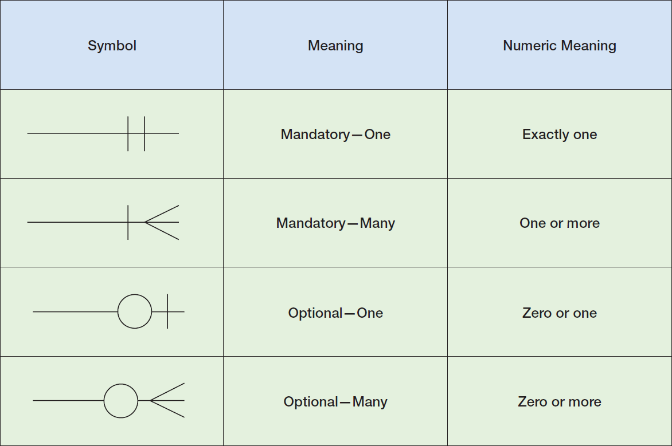
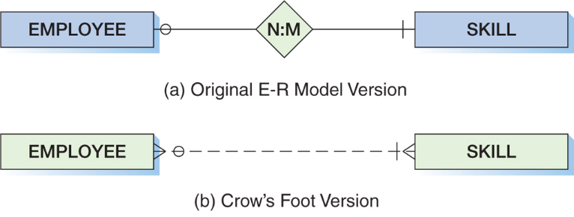
Crow’s Foot Symbols
Figure 4-8: Crow’s Foot Notation
Notes:
[Slides 4-20, 4-21]
Maximum cardinality is the maximum number of entity instances that may participate in a relationship instance.
Minimum cardinality is the minimum number of entity instances that must participate in a relationship instance.

Slide 28
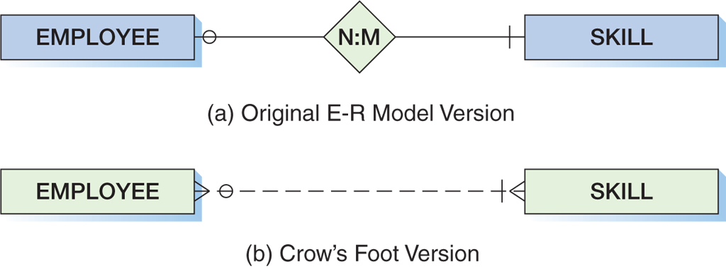
Crow’s Foot Example: Many-to-Many Relationship
Figure 4-9: Two Versions of an N:M Relationship
Notes:
An EMPLOYEE must have a SKILL and may have several. At the same time, although a particular SKILL may or may not be held by any EMPLOYEE, a SKILL may also be held by several EMPLOYEES.

Slide 29
Weak Entity
A weak entity is an entity that cannot exist in the database without the existence of another entity.
Any entity that is not a weak entity is called a strong entity.

Slide 30
ID-Dependent Weak Entities
An ID-Dependent weak entity is a weak entity that cannot exist without its parent entity.
An ID-dependent weak entity has a composite identifier.
The first part of the identifier is the identifier for the strong entity.
The second part of the identifier is the identifier for the weak entity itself.

Slide 31
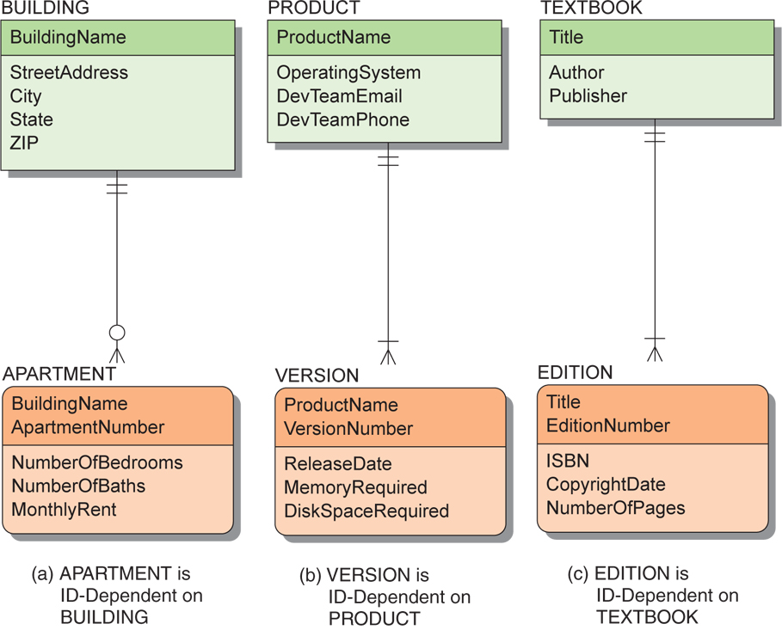
ID-Dependent Weak Entity Examples
Figure 4-10: Example ID-Dependent Entities
Notes:
As shown in Figure 4-10, in our E-R models we use an entity with rounded corners to represent the ID-dependent entity. We also use a solid line to represent the relationship between the ID-dependent entity and its parent. This type of a relationship is called an identifying relationship. A relationship drawn with a dashed line (refer to Figure 4-7) is used between strong entities and is called a nonidentifying relationship because there are no ID-dependent entities in the relationship.

Slide 32
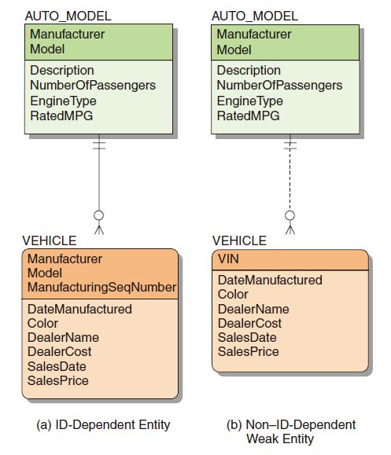
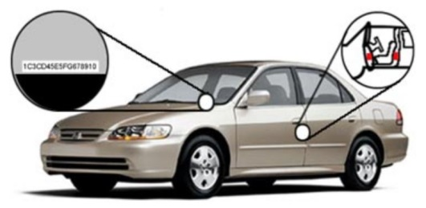
Weak Entity Relationships
The relationship between a strong and weak entity
is termed an identifying relationship if the weak entity is ID-dependent.
Represented by a solid line
is termed a nonidentifying relationship if the weak entity is non-ID-dependent.
Represented by a dashed line
Also used between strong entities
Notes:
As shown in Figure 4-10, in our E-R models we use an entity with rounded corners to represent the ID-dependent entity. We also use a solid line to represent the relationship between the ID-dependent entity and its parent. This type of a relationship is called an identifying relationship. A relationship drawn with a dashed line (refer to Figure 4-7) is used between strong entities and is called a nonidentifying relationship because there are no ID-dependent entities in the relationship.
VIN - Vehicle Identification Number 1.자동차 차대 번호
차량의 도난 방지와 차량의 결함을 추적하기 위한 일종의 꼬리표로, 차량 번호 또는 차량 식별 번호라고도 한다. 차대 번호는 자동차의 보닛(bonnet)을 열어 보면 크로스 멤버나 대시 패널부에 부착되어 있다. 자동차 제작사에서는 이 차대 번호를 별도 관리하여 차량의 결함 등이 발견되었을 경우, 해당 자동차를 추적하여 결함 내용이 사고로 이어지는 것을 사전에 방지할 수도 있다. 그러므로 어떤 자동차의 차대 번호를 알면 그 자동차의 제작 회사와 제작 시점 등 일련의 제작 과정을 알 수가 있다. 다만, 소비자 입장에서는 제작사에서 관리되고 있는 제작 과정의 자세한 내용들을 알 수가 없지만, 제작 회사와 제작 연도 등은 알 수 있도록 하였다. 차대 번호의 식별 방법은 다음과 같다. 17개의 자릿수 중 3번째에서 9번째까지는 제작사 자체적으로 설정된 부호와 약속에 의한 의미를 담고 있지만, 1, 2, 10, 12∼17번째 자리는 어느 회사이건 동일하다. 1번째는 국가, 2번째는 제작사, 10번째는 제작 연도, 12∼17번째는 제작 일련번호를 부여하고 있다.

Slide 33
Weak Entity Identifier: Non-ID-dependent
All ID-dependent entities are weak entities, but
there are other entities that are weak but not ID-dependent.
A non-ID-dependent weak entity may have a single or composite identifier,
but the identifier of the parent entity will be a foreign key.

Slide 34
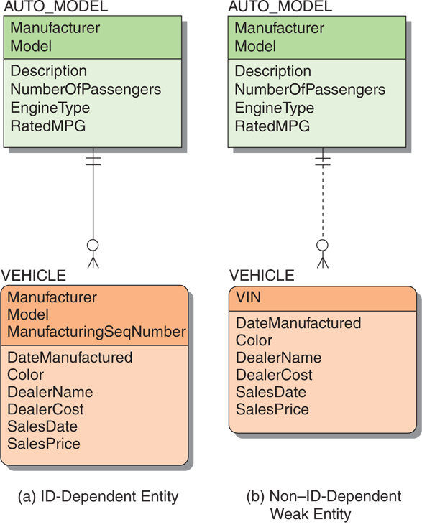
Non-ID-Dependent Weak Entity Examples
Figure 4-11: Weak Entity Examples
Notes:
VIN - Vehicle Identification Number 1.자동차 차대 번호

Slide 35
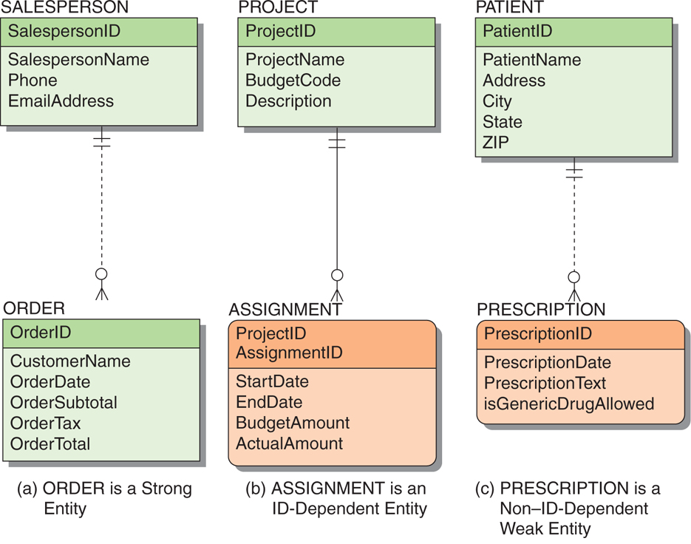
Strong and Weak Entity Examples
Figure 4-12: Examples of Required Entities
Notes:
To avoid such situations, some people interpret the definition of weak entity more narrowly. They say that to be a weak entity an entity must logically depend on another entity.
Although you might state that an ORDER must have a SALESPERSON, it does not necessarily require one for its existence. (The ORDER could be a cash sale in which the salesperson is not recorded.) Hence, the minimum cardinality of one arises from a business rule, not from logical necessity. Thus, ORDER requires a SALESPERSON but is not existence-dependent on it. Therefore, ORDER is a strong entity.
In this text, we define a weak entity as an entity that logically depends on another entity. Hence, not all entities that have a minimum cardinality of one in relation to another entity are weak. Only those that are logically dependent are weak.
gen·er·ic 1. 포괄적인, 총칭의 2. 회사 이름이 붙지 않은, 일반 명칭으로 판매되는

Slide 36
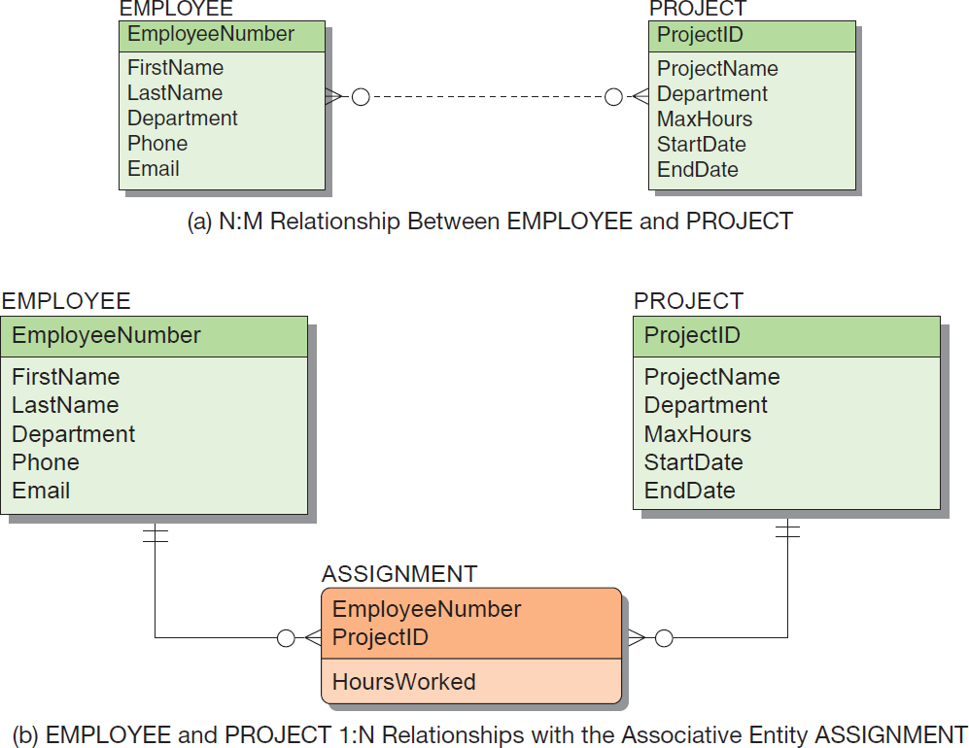
Associative Entities
An associative entity (also called an association entity) is used when there are attributes that are associated with the relationship between two entities rather than with either of the two entities themselves.
A new entity is then created to:
Link the two original entities
Hold the attributes
Notes:
Associative [ ə|soʊʃiətɪv ] 1. 연합의; 조합의; 연상의 2. 결합[연합, 연상]하기 쉬운

Slide 37
Associative Entities (Cont’d)
Figure 4-13: The Associative Entity

Slide 38
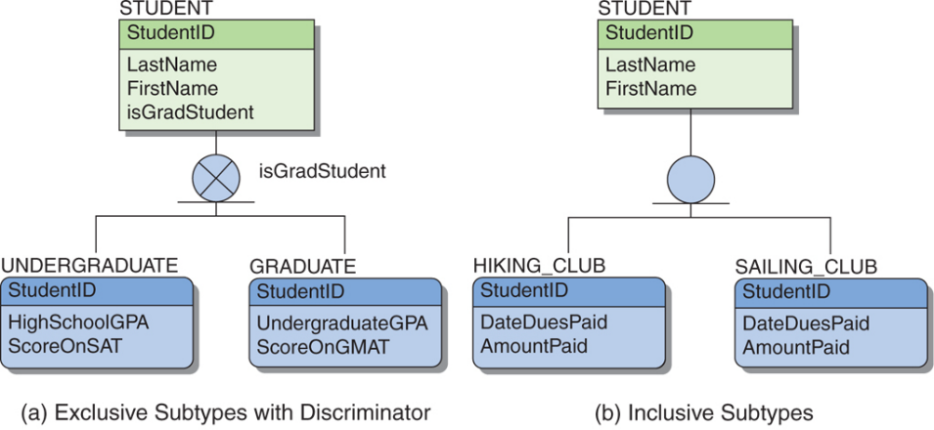
Subtype Entities
A subtype entity is a special case of another entity called supertype.
An attribute of the supertype may be included that
indicates which of the subtypes is appropriate for a given instance; discriminator
Subtypes can be exclusive or inclusive.
If exclusive, the supertype relates to at most one subtype.
If inclusive, the supertype can relate to one or more subtypes.
Notes:
As illustrated in Figure 4-14, in our E-R models we use a circle with a line under it as a subtype symbol to indicate a supertype/subtype relationship. Think of this as a symbol for an optional (the circle) 1:1 (the line) relationship.

Slide 39
Subtype Entity Identifiers
The relationships that connect supertypes and subtypes are called IS-A relationships
because a subtype is the same entity as the supertype.
The identifier of a supertype and all its subtypes must be the same
they all represent different aspects of the same entity
Notes:
Contrast this with HAS-A relationships, in which an entity has a relationship to another entity but the identifiers of the two entities are different. (4-24)
The relationships that connect supertypes and subtypes are called IS-A relationships (4-39)

Slide 40

Subtype Entity Examples
Figure 4-14: Example Subtype Entities
As illustrated in Figure 4-14, in our E-R models we use a circle with a line under it as a subtype symbol to indicate a supertype/subtype relationship. Think of this as a symbol for an optional (the circle) 1:1 (the line) relationship.
Notes:
As illustrated in Figure 4-14, in our E-R models we use a circle with a line under it as a subtype symbol to indicate a supertype/subtype relationship. Think of this as a symbol for an optional (the circle) 1:1 (the line) relationship. In addition, we use a solid line to represent an ID-dependent subtype entity because each subtype is ID-dependent on the supertype. Also note that none of the line end symbols shown in Figure 4-8 are used on the connecting lines. (“the circle”과 “the line”이 밀착되어 있다. “Figure 4-8”에는 밀착된 기호가 없다.)

Slide 41
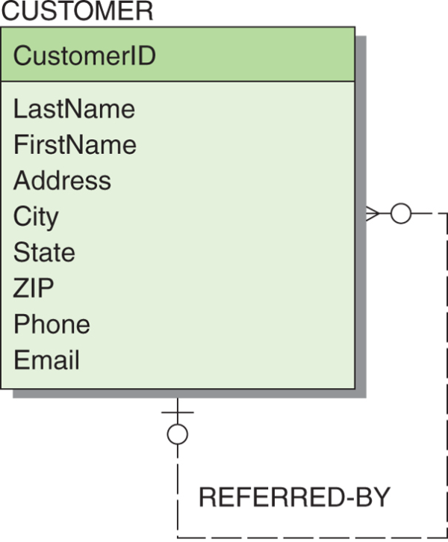
Recursive Relationships
It is possible for an entity to have a relationship to itself—this is called a recursive relationship.
Figure 4-15: Example Recursive Relationship
Notes:
Figure 4-15 shows a CUSTOMER entity in which one customer can refer to many other customers.
Figure 4-15 shows a CUSTOMER entity in which one customer can refer many other customers to the business.
자동사 1. 알아보다, 참조하다, 조회하다, 문의하다((for, to)). [refer+(前)+(名)] refer to a dictionary 사전을 찾다 refer to a former employer for a recommendation 추천할 만한 인물인가를 전고용주에게 문의하다.
타동사 2. (자료 따위를) 참조하게[찾아보게] 하다. He usually refers his pupils to this dictionary. 그는 보통 학생들에게 이 사전을 참조하라고 이른다. The asterisk refers the reader to a footnote. 별표(*)는 독자에게 각주(脚註)를 보라는 뜻이다.

Slide 42
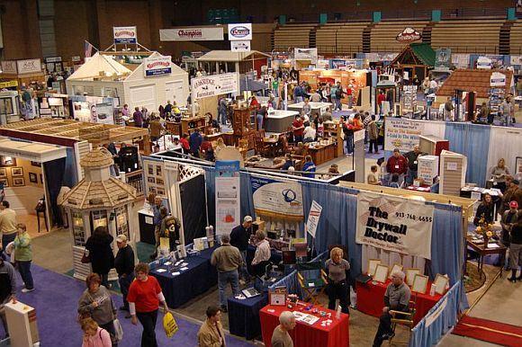
Developing an E-R Diagram
Heather Sweeney Designs will be used as an ongoing example throughout Chapters 4, 5, 6 and 7.
Heather Sweeney is an interior designer who specializes in home kitchen design.
She offers a variety of free seminars at home shows, kitchen and appliance stores and other public locations.
She earns revenue by selling books and videos that instruct people on kitchen design.
She also offers custom-design consulting services.
She would like to develop a database
to keep track of customers,
the seminars they have attended,
the contacts she has made with them, and
the purchases they have made.
She wants to use this database
to continue to contact her customers and
offer them products and services
Notes:
내셔널 홈 쇼에서는 전문 인테리어 디자이너들이 상담센터를 운영하여 행사장을 방문한 분들에게 인테리어 디자인 고민을 해결해주고 레노베이션 전문가들에게 집 개조 및 보수에 대해 상담을 받을 수 있습니다. 또한, 집과 정원 인테리어에 …

Slide 43
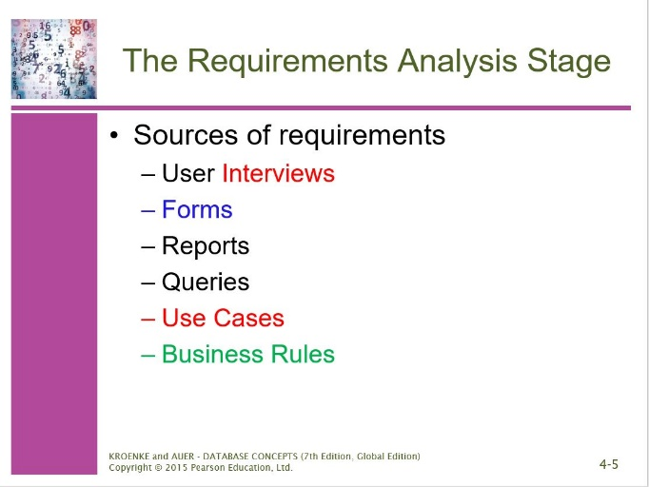
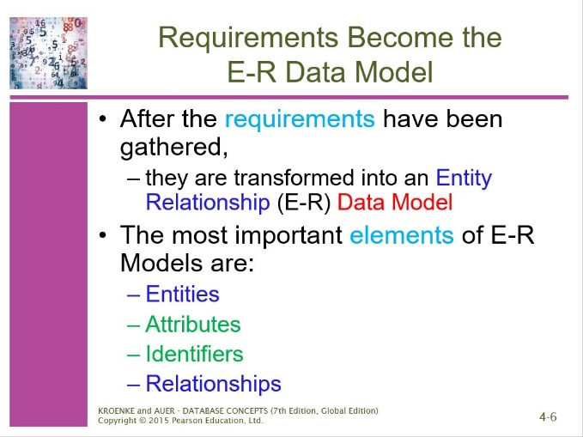
Developing an E-R Diagram
Heather Sweeney Designs will be used as an ongoing example throughout Chapters 4, 5, 6 and 7.
She would like to develop a database
to keep track of customers,
the seminars they have attended,
the contacts she has made with them, and
the purchases they have made.
She wants to use this database
to continue to contact her customers and
offer them products and services
Notes:
내셔널 홈 쇼에서는 전문 인테리어 디자이너들이 상담센터를 운영하여 행사장을 방문한 분들에게 인테리어 디자인 고민을 해결해주고 레노베이션 전문가들에게 집 개조 및 보수에 대해 상담을 받을 수 있습니다. 또한, 집과 정원 인테리어에 …

Slide 44
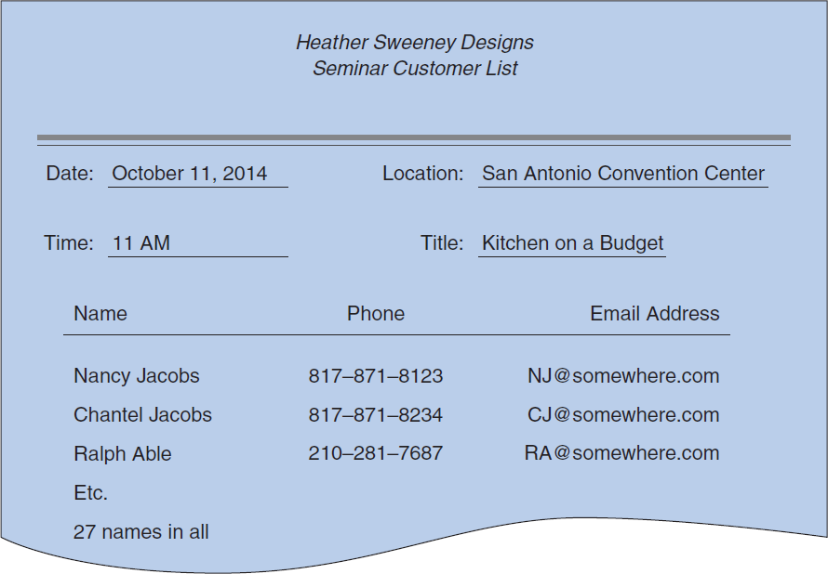
Heather Sweeney Designs: The Seminar Customer List
Figure 4-16: Example Seminar Customer List - the form that Heather or her assistant fills out at seminars
Notes:
Figure 4-16 shows the seminar customer list form that Heather or her assistant fills out at seminars. This form includes basic data about the seminar as well as the name, phone, and email address of each seminar attendee. If we examine this list in terms of a data model, you see two potential entities: SEMINAR and CUSTOMER. From the form in Figure 4-16, we can conclude that a SEMINAR relates to many CUSTOMERs, and we can make the initial E-R diagram shown in Figure 4-17(a).
However, from this single document we cannot determine a number of other facts. For example, we are not sure about cardinalities. Currently, we show a 1:N relationship, with both entities required in the relationship, but we are not certain about this. Neither do we know what to use for the identifier of each entity.

Slide 45
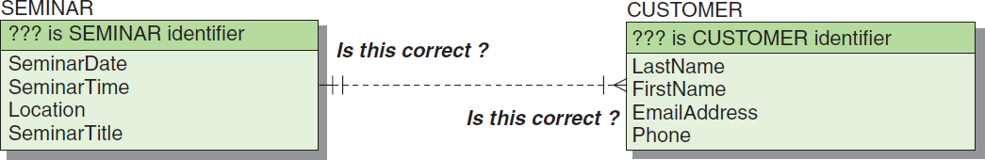
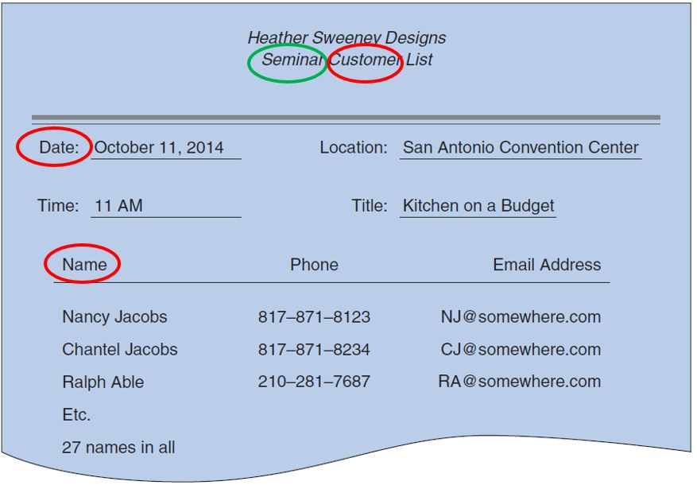
Heather Sweeney Designs: Initial E-R Diagram I
(a) First Version of the SEMINAR and CUSTOMER E-R Diagram
Figure 4-17: Initial E-R Diagram for Heather Sweeney Designs
Notes:
However, from this single document we cannot determine a number of other facts. For example, we are not sure about cardinalities. Currently, we show a 1:N relationship, with both entities required in the relationship, but we are not certain about this. Neither do we know what to use for the identifier of each entity.

Slide 46
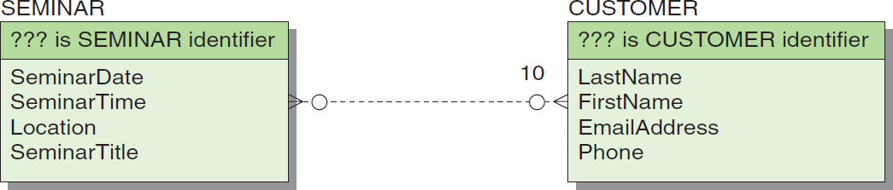
Heather Sweeney Designs: Initial E-R Diagram II
(b) Second Version of the SEMINAR and CUSTOMER E-R Diagram
Figure 4-17: Initial E-R Diagram for Heather Sweeney Designs
Notes:
Suppose we talk with Heather and determine that customers can attend as many seminars as they would like, but she would like to be able to record customers even if they have not been to a seminar. (“Frankly, I’ll take a customer wherever I can find one!” was her actual response.) Also, she never offers a seminar to fewer than 10 attendees. Given this information, you can fill out more of the E-R diagram, as shown in Figure 4-17(b).
The notation says that a seminar must have at least 10 customers, which is what we were told. However, this means that we cannot add a new SEMINAR to the database unless it already has 10 customers. This is incorrect. When Heather first schedules a seminar, it probably has no customers at all, but she would still like to record it in the database. Therefore, even though she has a business policy of requiring at least 10 customers at a seminar, we cannot place this limit as a constraint in the data model.

Slide 47
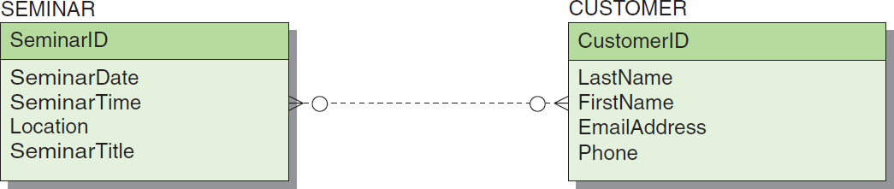
Heather Sweeney Designs: Initial E-R Diagram III
(c) Third Version of the SEMINAR and CUSTOMER E-R Diagram
Figure 4-17: Initial E-R Diagram for Heather Sweeney Designs
Notes:
For SEMINAR, the composites (SeminarDate, SeminarTime, Location) and (SeminarDate, SeminarTime, SeminarTitle) are probably unique, and either could be the identifier. However, identifiers will become table keys during database design, and these will be large character keys. A surrogate key is probably a better idea here, so we should create an equivalent unique identifier (SeminarID) for this entity. For CUSTOMER, looking at the data and thinking about the nature of email addresses, we can reasonably suppose that EmailAddress can be the identifier of CUSTOMER. However, some couples share an email address, and it may not be completely unique. Therefore, we will use CustomerID as our unique identifier. All these decisions are shown for the E-R diagram in Figure 4-17(c).

Slide 48
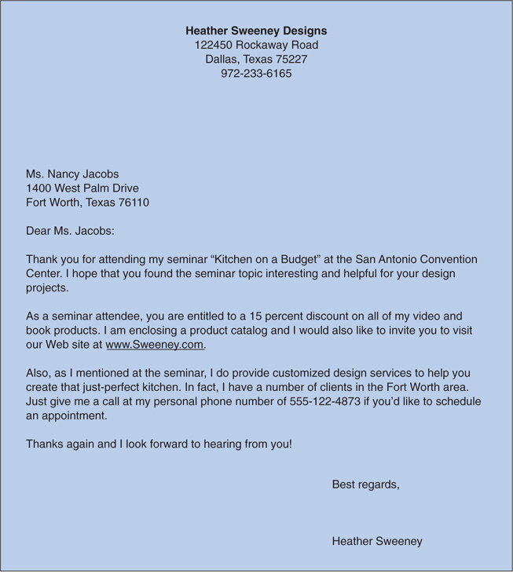
Heather Sweeney Designs: The Customer Form Letter
Heather records every customer contact she makes.
She considers customer attendance at a seminar as one type of customer contact and
a form letter that Sweeney Designs uses as another type of customer contact and as a follow-up to seminar attendance.
Reading the form letter, we see that it refers to both a seminar and a customer.
Therefore, we can add it to the E-R diagram with relationships to both of those entities, as shown in Figure 4-19.
Figure 4-18: Heather Sweeney Designs Customer Form Letter

Slide 49
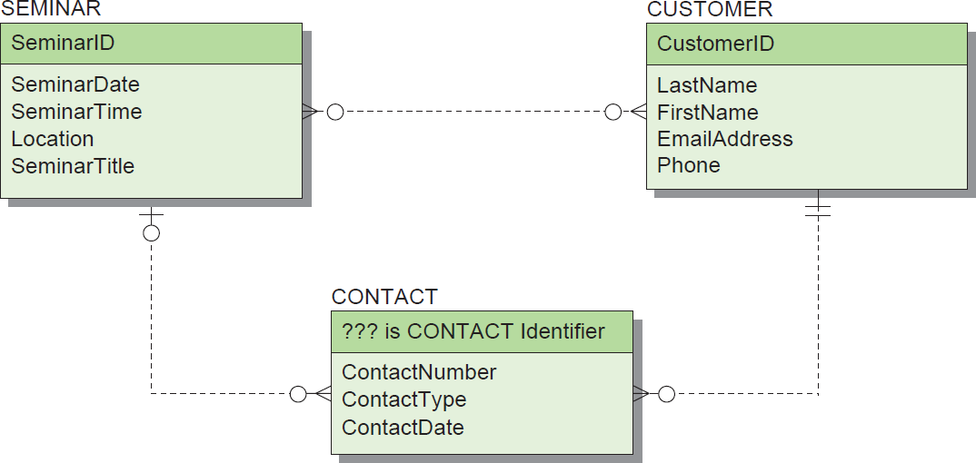
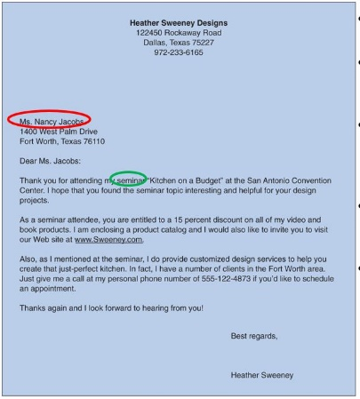
Heather Sweeney Designs: Data Model with CONTACT
(a) First Version with CONTACT
Figure 4-19: Heather Sweeney Designs Data Model with CONTACT
Notes:
As shown in the design in Figure 4-19(a), a seminar can result in many contacts and a customer may receive many contacts, so the maximum cardinality of these relationships is N.
However, neither a customer nor a seminar need generate a contact, so the minimum cardinality of these relationships is zero.
Working from CONTACT back to SEMINAR and CUSTOMER, we can determine that the contact is for a single CUSTOMER and refers to a single SEMINAR, so the maximum cardinality in that direction is one.
Also, some of the messages to customers refer to seminars and some do not, so the minimum cardinality back to SEMINAR is zero.
However, a contact must have a customer, so the minimum cardinality of that relationship is one. These cardinalities are shown in Figure 4-19(a).

Slide 50
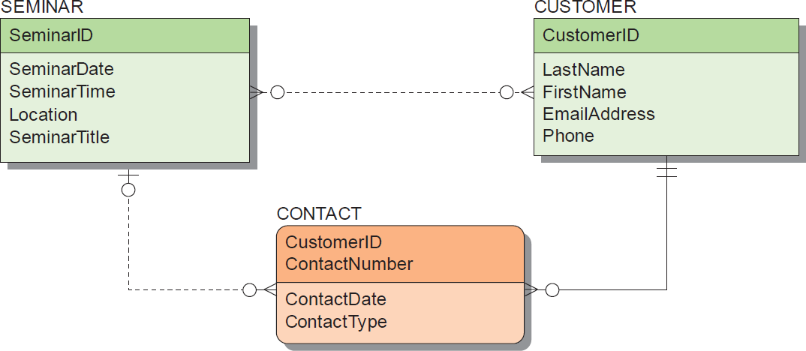
Heather Sweeney Designs: Data Model with CONTACT as Weak Entity
(b) Second Version with CONTACT as a Weak Entity
Figure 4-19: Heather Sweeney Designs Data Model with CONTACT
Notes:
Could it be that CONTACT is a weak entity? Can a CONTACT logically exist without a SEMINAR? Yes, because not all CONTACTs refer to a SEMINAR. Can a CONTACT logically exist without a CUSTOMER? The answer to that question has to be no. Who would we be contacting without a CUSTOMER? Aha! That is it: CONTACT is a weak entity, depending on CUSTOMER. In fact, it is an ID-dependent entity because the identifier of CONTACT includes the identifier of CUSTOMER.
After further interviews with Heather, we determine that she often contacts a customer more than once on the same day (both the form letter and email message thanking the customer for seminar attendance are always sent on the same day), so (CustomerID, Date) cannot be the identifier of CONTACT. We will choose to use the ContactNumber attribute, which is a simple sequence number, as the second part of the composite identifier (CustomerID, ContactNumber) for CONTACT.

Slide 51
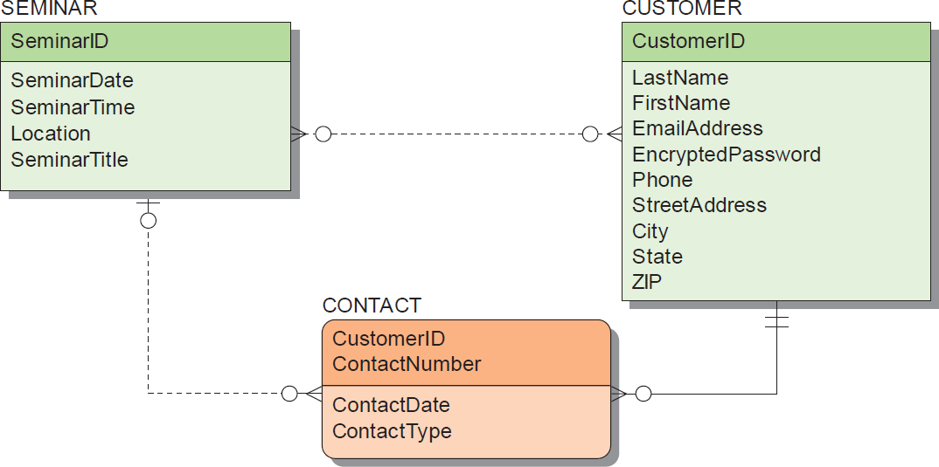
Heather Sweeney Designs: Data Model with Modified CUSTOMER
(c) Third Version with Modified CUSTOMER
Figure 4-19: Heather Sweeney Designs Data Model with CONTACT
Notes:
Heather has some other data requirements. First, the contact letter has the customer’s address, but the CUSTOMER entity has no address attributes. Consequently, they need to be added. Second, Heather allows customers to create a login account on her Web site so that they can purchase items online securely. She uses the customer EmailAddress as their login name, and has them create a password. For security, we need to allow for encryption of this password and storage of it in the CUSTOMER entity.

Slide 52
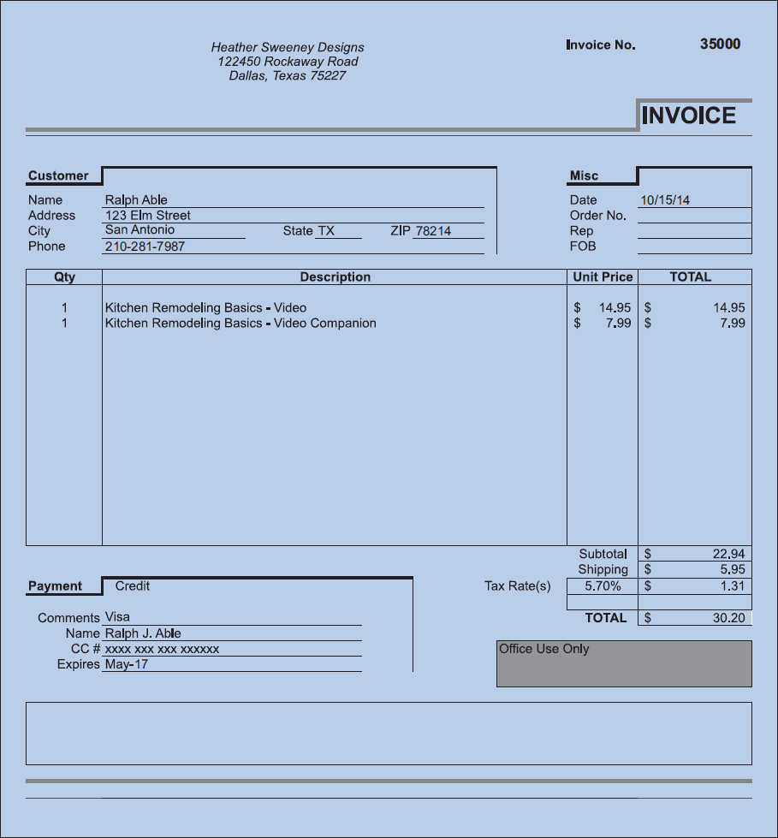
Heather Sweeney Designs: Sales Invoice
Figure 4-20: Heather Sweeney Designs Sales Invoice
Notes:
Invoice [ˈɪnvɔɪs] (n.) "written account of the particulars and prices of merchandise shipped or sent," 1550s, apparently from a re-Latinized form of French envois, plural of envoi "dispatch (of goods)," literally "a sending," from envoyer "to send," from Vulgar Latin *inviare "send on one's way," from Latin in "on" (from PIE root *en "in") + via "road" (see via (adv.)). As a verb, 1690s, from the noun.
invoice [ˈɪnvɔɪs] 1. [명사] 송장(送狀), (물품 대금작업비 등의) 청구서(=bill) 2. [동사][상업] (물품 대금작업비 등의) 청구서[송장]를 보내다
The sales invoice that Heather uses to sell books and videos is shown in Figure 4-20. The sales invoice itself needs to be an, entity and because the sales invoice has customer data it has a relationship back to CUSTOMER.

Slide 53
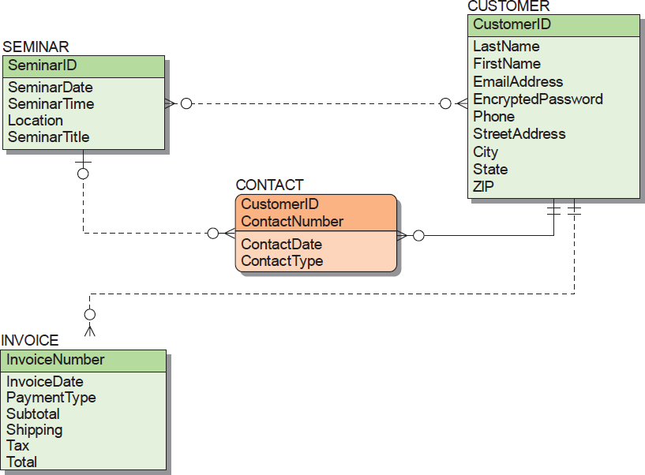
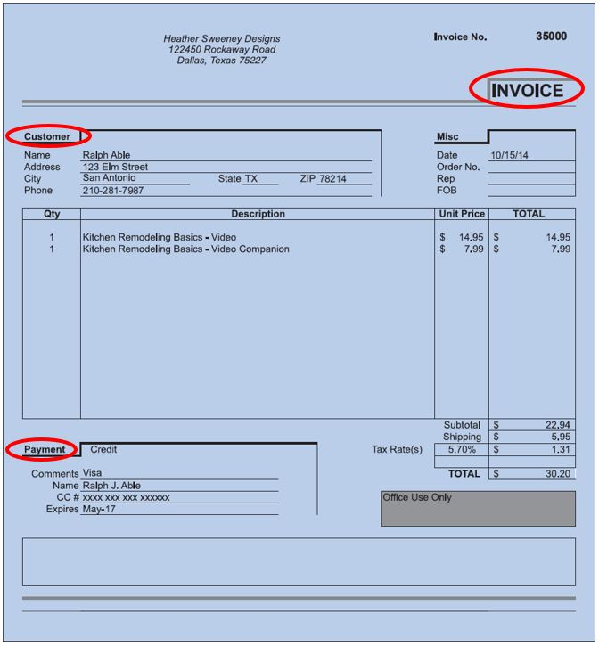
Heather Sweeney Designs: Data Model with INVOICE
(a) Version with INVOICE
Figure 4-21: The Final Data Model for Heather Sweeney Designs
Notes:
The sales invoice that Heather uses to sell books and videos is shown in Figure 4-20. The sales invoice itself needs to be an entity, and because the sales invoice has customer data it has a relationship back to CUSTOMER.
Figure 4-21(a) shows a first attempt at the data model with INVOICE. This diagram is missing data about the line items on the order. Because there are multiple line items, the line item data cannot be stored in INVOICE. Instead, an ID-dependent entity, LINE_ITEM, must be defined. The need for an ID-dependent entity is typical for documents that contain a group of repeating data. If the repeating group is not logically independent, then it must be made into an ID-dependent weak entity. Figure 4-21(b) shows the adjusted design.

Slide 54
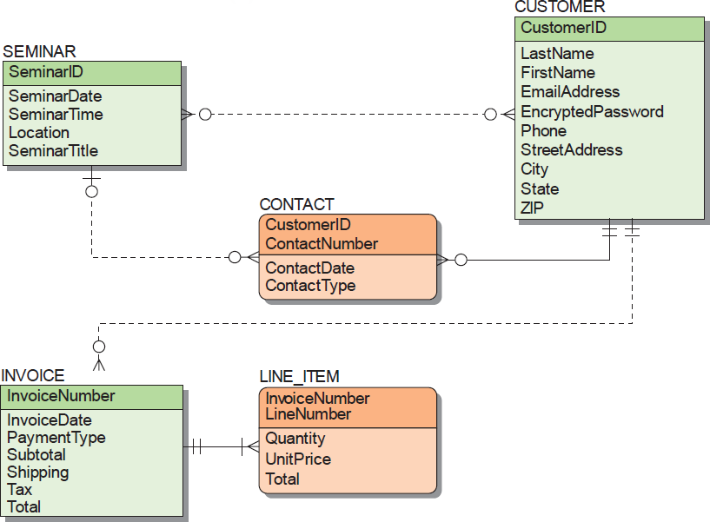
Heather Sweeney Designs: Data Model with LINE_ITEM
(b) Version with LINE_ITEM
Figure 4-21: The Final Data Model for Heather Sweeney Designs
Notes:
Figure 4-21(a) shows a first attempt at the data model with INVOICE. This diagram is missing data about the line items on the order. Because there are multiple line items, the line item data cannot be stored in INVOICE. Instead, an ID-dependent entity, LINE_ITEM, must be defined. The need for an ID-dependent entity is typical for documents that contain a group of repeating data. If the repeating group is not logically independent, then it must be made into an ID-dependent weak entity. Figure 4-21(b) shows the adjusted design.
Heather sells standard products—that is, her books and videos have standardized names and prices. She does not want the person who fills out an order to be able to use nonstandard names or prices. We therefore need to add a PRODUCT entity and relate it to LINE_ITEM, as shown in Figure 4-21(c).

Slide 55
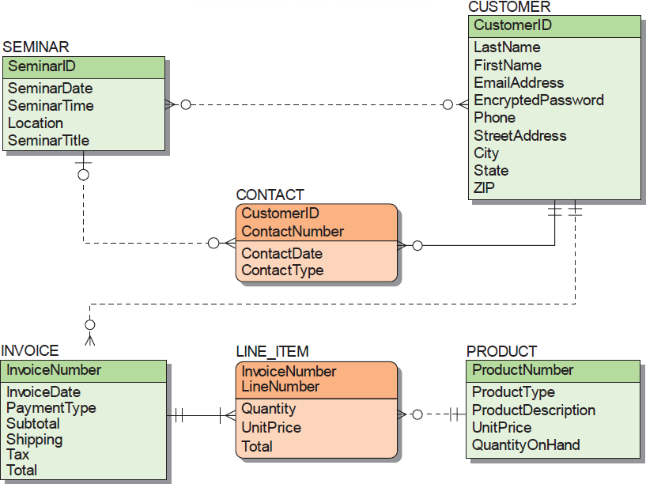
Heather Sweeney Designs: Final Data Model
(c) The Finished Data Model
Figure 4-21: The Final Data Model for Heather Sweeney Designs
Notes:
Heather sells standard products—that is, her books and videos have standardized names and prices. She does not want the person who fills out an order to be able to use nonstandard names or prices. We therefore need to add a PRODUCT entity and relate it to LINE_ITEM, as shown in Figure 4-21(c).
Observe that UnitPrice is an attribute of both PRODUCT and LINE_ITEM. This was done so that Heather can update UnitPrice without affecting the recorded orders. At the time a sale is made, UnitPrice in LINE_ITEM is set equal to UnitPrice in PRODUCT. The LINE_ITEM UnitPrice never changes. However, as time passes and Heather changes prices for her products she can update UnitPrice in PRODUCT. If UnitPrice were not copied into LINE_ITEM, when the PRODUCT price changes, the price in already stored LINE_ITEMs would change as well, and Heather does not want this to occur. Therefore, although two attributes are named UnitPrice, they are different attributes used for different purposes.
Note in Figure 4-21(c) that based on interviews with Heather we have added ProductNumber and QuantityOnHand to PRODUCT. These attributes do not appear in any of the documents, but they are known by Heather and are important to her.

Slide 56
Heather Sweeney Designs: Business Rules and Model Validation
Business rules may constrain the model and need to be recorded.
We encountered such a business rule with regard to CONTACT,
when Heather Sweeney stated multiple contacts, e.g.
more than one email message, may be made with one customer on the same day
so (CustomerID, Date) cannot be the identifier of CONTACT
After the data model has been completed, it needs to be validated.
Prototyping is commonly used to validate forms and reports.
Notes:
proto·type [ |proʊtətaɪp ] 명사 1. a. 원형, 기본형. b. 모범, 모델, 본보기가 되는 사람[것]. c. 후대의 것과 유사한 것. d. 시작품(試作品), 시제품. e. (생물) 원형, 원시형. f. (신학) 원형 그리스도. 동사 1. 원형[시작품]을 만들다.

Slide 57
Data Modeling and the Entity-Relationship Model
DAVID M. KROENKE and DAVID J. AUER
DATABASE CONCEPTS, 7th Edition, Global Edition
End of Presentation on Chapter Four

